Slide 1
Twin Momentum
By Dashan Huang, Huacheng Zhang, and Guofu Zhou (2017)
Presented by Hejiang Xie

Slide 2
Outline
Introduction
Data and Key Variables
Fundamental Momentum
Twin Momentum
Robustness
Conclusions

Slide 3
1. Introduction
New factor: fundamental momentum
Use moving average to capture more information
Use a set of fundamental variables
Different from price momentum
Combining the two together can give better result

Slide 4
2. Data and Key Variables
Accounting information: January 1973 - August 2015
7 fundamental variables:
return on equity (ROE)
return on asset (ROA)
earnings per share (EARN)
accrual-based operating profitability to equity (APE)
cash-based operating profitability to assets (CPA)
gross profitability to assets (GPA)
net payout ratio (NPY)

Slide 5
2. Data and Key Variables
Special treatment of these 7 variables discussed, mostly consistent with previous literatures
2 reasons why a commonly used factor standard unexpected earnings (SUE) not included
already considered earnings per share (EARN)
Literatures showed that SUE is partly included in ROE
Robustness test section shows that the result still hold when choosing different subset of these fundamental variables

Slide 6
3. Fundamental Momentum
3.1 Fundamental Implied Return (FIR)
3.2 Fundamental Momentum Return
3.3 Why do fundamental trends have forecasting power
3.4 Fundamental momentum versus price momentum

Slide 7
3.1 Fundamental Implied Return (FIR)
Price momentum
Construction of quantile portfolio
Sort into 5 groups based on the cumulative return over t-12 to t-2
at least 8 observations
Go long past winner and short past loser
Value weighted, monthly rebalance
Fundamental momentum: 3 steps to get FIR
Calculate the MAs for fundamental variables
Cross-Sectional Regression
Forecast return: FIR

Slide 8
3.1 Fundamental Implied Return (FIR)
Getting FIR: Calculate MAs for fundamental variables
$$MA_{i,q,L}^{k}=\frac{F_{i,q}^{k}+F_{i,q−1}^{k}+...+F_{i,q−L+1}^{k}}{L}$$
where:
i is different firms
q is different months
k is different fundamental variables (7 in total)
L is the lagged period of the moving average, L = 1,2,4,8, four MAs for each fundamental variables, 4 * 7 = 28 in total
require at least 50% of the observations available in each MAs, L in the denominator will adjust accordingly if there's missing points.

Slide 9
3.1 Fundamental Implied Return (FIR)
Example:
$$MA_{APPL,2ndQuarter2017,4}^{ROE}$$
$$=\frac{F_{AAPL,2ndQuarter2017}^{ROE}+F_{AAPL,1stQuarter2017}^{ROE}+F_{AAPL,4thQuarter2016}^{ROE}+F_{AAPL,3rd2016}^{ROE}}{4}$$
if the ROE information for AAPL is unavailable at 1st quarter of 2017, then
$MA_{APPL,2ndQuarter2017,4}^{ROE}=\frac{ROE_{AAPL,2ndQuarter2017}^{ROE}+F_{AAPL,4thQuarter2016}^{ROE}+F_{AAPL,3rd2016}^{ROE}}{3}$
The paper didn't mention if there's too many missing observations, I suppose that this specific MA observation is abandoned

Slide 10
3.1 Fundamental Implied Return (FIR)
Getting FIR: Cross-Sectional Regression
$$R_{i,t}=α_{t}+\sum_{L=1,2,4,8}{\sum_{k=1}^{7}{β_{L,t}^{k}}}∗MA_{i,t−1,L}^{k}+ε_{i,t}$$
where:
t is each month
i is individual stocks
Double sum looks complicated, but actually it's just the 4 different lagging period * 7 different fundamental variables, 28 explanatory variables

Slide 11
3.1 Fundamental Implied Return (FIR)
Getting FIR: Forecast return
$$FIR_{i,t}=\sum_{L=1,2,4,8}{\sum_{k=1}^{7}{E_{t}}}[β_{L,t+1}^{k}]∗MA_{i,t,L}^{k}$$
Next period expectation $E[β_{t+1}^{k}]$ is defined as $E[β_{t+1}^{k}]=β_{t}^{k}$, ie. use previous period regression $β$ as the predicted $β$ for next period
I think here maybe more sophisticated way like GARCH can be used to get a more accurate prediction of $E[β_{t+1}^{k}]$
Intercept not included because the FIR is used to sort the stocks, intercept is the same cross-sectionally and does not change anything in sorting
This is an out-of-sample prediction, only use the information before so there's no in-sample bias

Slide 12
3.2 Fundamental Momentum
Each month, sort all stocks into five value-weight portfolios by their FIRs, go long the top FIR group and short the bottom FIR group
Result shown in table 1

Slide 13
3.2 Fundamental Momentum
Sort on single variables:
Good mean returns
But explainable by models
Sort on single variables with trend (MA):
Improve the results
But still explainable by models (HXZ)
Sort on multiple variables with trends (MA):
Further improve performance
Model alphas significant

Slide 14
3.3 Why do fundamental trends have forecasting power
Sticky expectation
$$π_{t+1}=s_{t}+ε_{t+1}$$
$$s_{t+1}=ρs_{t}+u_{t+1}$$
where
$π_{t+1}$ is the next period forecast profit
$s_{t}$ is some signal variable
$ρ<1$ and $ε$ and $u$ are white noise

Slide 15
3.3 Why do fundamental trends have forecasting power
Let $E_{t}^{∼}(π_{t+h})$ and $E_{t}(π_{t+h})$ denote subjective and objective expectations at time $t$ about profit at $t+h$ : $π_{t+h}$ and follow process
$$E_{t}^{∼}(π_{t+h})=(1−λ)E_{t}(π_{t+h})+λE_{t−1}^{∼}(π_{t+h})$$
it's a weighted average between last period subjective expectation and this period objective expectation
$λ$ is the expectation stickiness,
When $λ$ is large, we tend to stick to last period's subjective expectation
The most ideal way is $λ=0$ because we need an objective expectation but we don't want to overreact, so the weighting scheme should be 1 and 0
When $0<λ<1$ expectation is sticky and investors will insufficiently incorporate new information into their forecast
When $λ<0$, investors will overreact

Slide 16
3.3 Why do fundamental trends have forecasting power
Literatures showed that in real market the expectations are indeed sticky i.e. $0<λ<1$ and also generated a relationship between profit and future stock returns:
$$Cov(R_{t+1},π_{t})=(1+mρ)\frac{λ^{2}ρσ_{u}^{2}}{1−λρ^{2}}>0$$
where $m=\frac{1−λ}{1+r−ρ}$ and $r$ is risk free rate
If we plug in the definition of Moving Average
$$Cov(R_{t+1},MA_{t,L})=(1+mρ)\frac{λ^{2}ρσ_{u}^{2}}{1−λρ^{2}}\frac{1−(λρ)^{L}}{1−λρ}$$
When$0<λ<1andL>1$, and the new term $\frac{1−(λρ)^{L}}{1−λρ}$ is larger than 1 so the MAs have higher covariance with the future returns and thus have better prediction power

Slide 17
3.4 Fundamental momentum versus price momentum
Compares the two momentum, and showed that they are different
Three methods:
Bivariate portfolio analysis
Fama-MacBeth regression
Decomposition of cash flow, discount rate, and variance

Slide 18
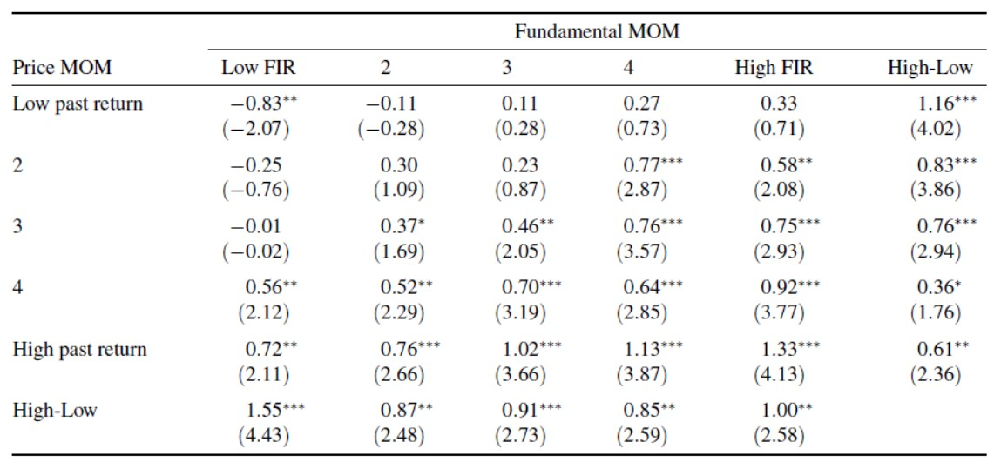
3.4.1 Fundamental momentum versus price momentum Bivariate portfolio analysis
Double sort according to past returns and FIR: 5*5 portfolio
Table 2 summarize the return of these portfolios
In each past return quantile, average return increase with FIR
In each FIR group, average return increase with past return
Past losers has stronger fundamental momentum!
Indicates that fundamental momentum is not the same as price momentum. Or otherwise the effect should disappear within each past return group

Slide 19
3.4.2 Fundamental momentum versus price momentum Fama-MacBeth Regression
Run cross sectional regression of stock returns on past returns and FIR
Advantage is that cross sectional regression can control for other firm characteristics. And this paper control for
short-term reversal (stock return in month t - 1
long-term reversal (cumulative stock return between month t-60 and month t-13)
log market capitalization (log size)
book-to-market (B/M)
idiosyncratic volatility (IVOL)

Slide 20
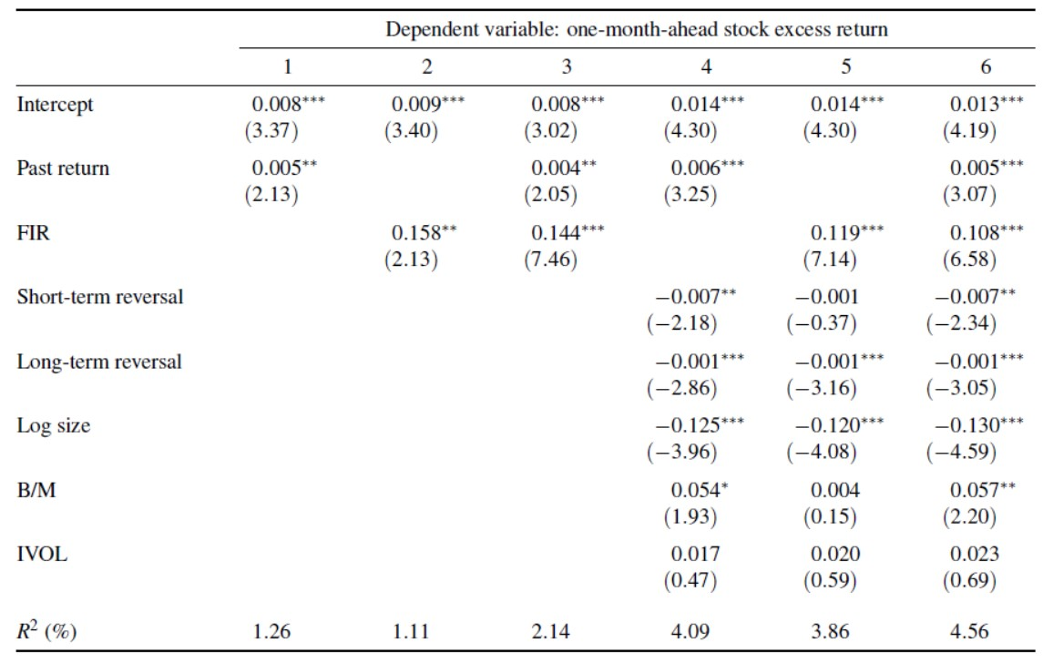
3.4.2 Fundamental momentum versus price momentum Fama-MacBeth Regression
Regression results shown in table 3
The slopes are all significant in column 3, indicating that price momentum and fundamental momentum coexist!
My doubt
The paper says cross-sectional regression, I’m not sure which period the result table is
If it is a time series regression, it might over look the autocorrelation (Wikipedia: for holding period longer than weekly, Fama-MacBeth regression is inappropriate)

Slide 21
3.4.3 Fundamental momentum versus price momentum Cash flow, discount rate, and variance betas
Literatures suggest that unexpected returns on the market portfolio can be decomposed into two components: shocks on future cash flows and shocks on discount rates
Campbell, Giglio, Polk, and Turley (2017) extend this model and add that the variance of stock return
Follow this model, run time-series regressions momentum returns on shocks about future cash flows, discount rate, and variance of the aggregate market
$$r_{i}=β_{0}+β_{cf}N_{cf}+β_{dr}N_{dr}+β_{v}N_{v}+ε_{i}$$

Slide 22
3.4.3Fundamental momentum versus price momentum Cash flow, discount rate, and variance betas
Results is shown in table 4
Price momentum and fundamental momentum are related. Same sign of the betas. Consistent with previous papers
Cash flow betas insignificant: returns do not come from here
Betas of price MOM is much larger, R^2 is higher as well

Slide 23
4 Twin Momentum
Combine the two momentum: Twin Momentum
Double sort to form 5*5 portfolio: Buys portfolio with top past return and FIR quintiles and sells the opposite
Analysis of the Twin Momentum strategy
Average Return
Risk Adjusted Return
Mean-Variance Spanning Test
Long-Short Leg Analysis

Slide 24
4.1 Twin Momentum: Average Return
Panel A:
Return of twin momentum is higher than the sum of two individual
Skew more close to zero
Possibility of past return > 0.5
Small correlation! Reason of synergy!
Panel B:
Twin momentum exist in each period and is not declining
Price momentum is declining but fundamental momentum is not
Price momentum has a large negative skewness in the most recent sample period, it drive the whole period skewness to negative

Slide 25
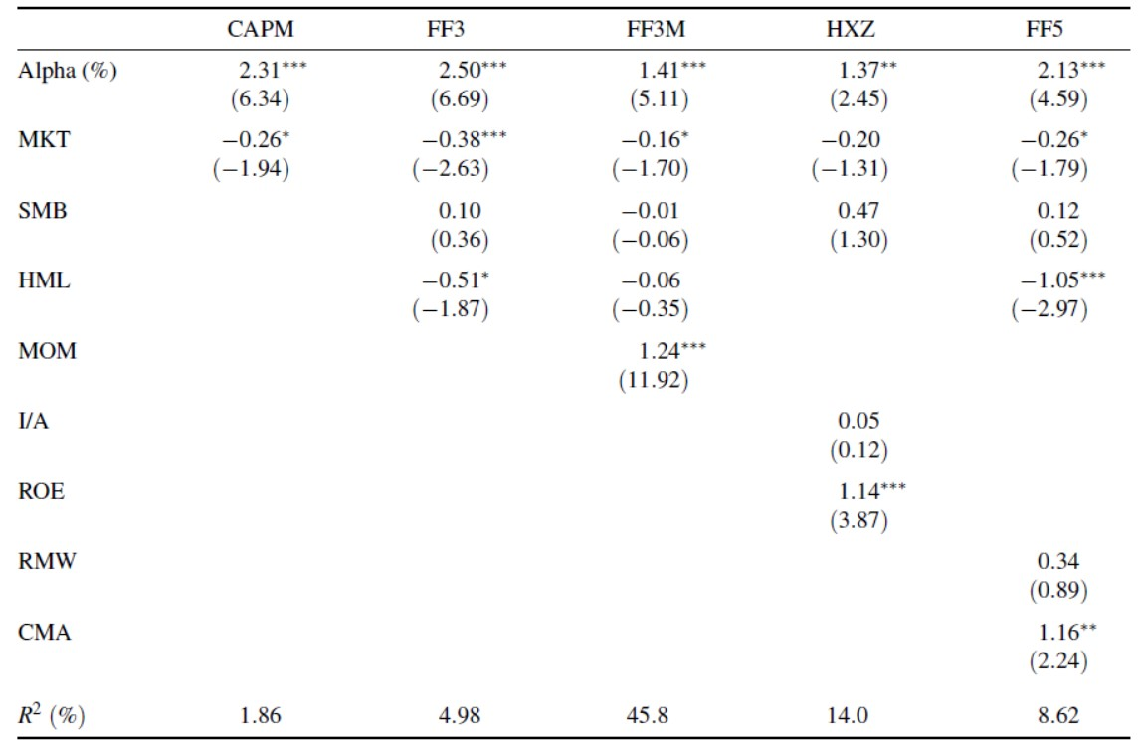
4.2 Twin Momentum: Risk-adjusted Return
regress the twin momentum portfolio return on asset pricing model’s factor returns. Table 6 shows the result
All alphas are significant!
FF3M, HXZ, and FF5 models have some power to explain the twin momentum profit: lower alpha and higher R^2
MOM in FF3M, ROE in HXZ and CMA in FF5
SMB has no power explaining twin momentum return!
R^2 of FF3M is very high:
MOM factor can explain the price momentum component in the twin
Also, at least half of the twin momentum can not be explained!

Slide 26
4.3 Mean-variance spanning tests
For investors that holds a well-diversified portfolio, twin momentum will add value on if it lies outside the mean-variance frontier, other wise it can be constructed using other assets
Run time-series regression of the twin momentum portfolio return on the factor returns in each asset pricing model
$$R_{t}=α+\sum_{j=1}^{M}{β_{j}}f_{j,t}+ε_{t}$$
Previous papers showed that testing whether it is in the mean-variance frontier is equivalent to test the following hypothesis:
$$H_{0}:α=0,\sum_{j=1}^{M}{β_{j}}=1$$
Used 6 tests: results are all significant

Slide 27
4.4 Long- and Short-leg Analysis
Past paper showed that due to arbitrage asymmetry, investors have greater ability or willingness to take a long position and less likely to take short position when perceiving mispricing in a stock
As a result, most anomaly returns in the literature is from the short leg

Slide 28
4.4 Long- and Short-leg Analysis
The return of short leg should be negative (because we should short them)
For price momentum:
Return from long leg is much higher than the short leg
Some model can fully explain price momentum
Long leg alphas are lower than short leg alphas
Results consistent with past literatures
For fundamental momentum:
Alphas of long and short leg are of the same size

Slide 29
4.4 Long- and Short-leg Analysis
For twin momentum:
Return is high! Short leg contributes!
Long leg alphas are all significant, so it is unlikely that twin momentum is to be driven by only short sell constraints
I slightly disagree:
I doubt that 10% is render significant as mentioned by Phil
Although the long leg alphas are significant, but the scale of the these alphas are much smaller than the short leg alphas. The risk adjusted returns may still be contributed mostly by short legs
But I do agree that the fundamental momentum is quite promising

Slide 30
5 Robustness
Size effect
Transaction cost
Impact of investor sentiment
Estimate FIR with alternative formation periods
Alternative twin momentum with single sort

Slide 31
5.1 Robustness: Size effect
Small cap has always been a significant factor. Small firms tends to have higher mispricing situations
Prove that twin momentum return is not generate by focusing on small cap firms
Exclude small firms with market cap under certain percentile to see whether twin momentum is still valid

Slide 32
5.1 Robustness: Size effect
twin momentum strategy is still robust, although the return decreases.
Even after we excludes 80% small stocks the alpha are still significant
Also proves that twin momentum is not generated by market short selling frictions: large cap stocks have much better liquidity and suffer less from restrictions to short selling

Slide 33
5.2 Robustness: Transaction cost
In past literatures, price momentum strategies often have high turn over ratios
Transaction cost may offset the returns
Calculate break even cost
what level of transaction cost makes the strategy's return exactly zero
what level of transaction cost makes the return statistically 5% significant

Slide 34
5.2 Robustness: Transaction cost
The turn-over ratio for twin momentum is much higher than the other two, which is reasonable because it is a 5*5 sort and thus it is a finer sort so the rebalancing may be more
The break even transaction cost are all quite high, which suggest that the profit is not likely to be offset by transaction cost.

Slide 35
5.3 Robustness: Impact of investor sentiment
Examines how much the profitability is related with investor sentiment
Previous literatures defined an investor sentiment index
Follow that index and divide all sample period into high and low sentiment period. Analyze the three strategies in each period

Slide 36
5.3 Robustness: Impact of investor sentiment
The paper says "During high sentiment periods, the most optimistic views tend to overly optimistic and stocks are more likely overpriced. In contrast, during low sentiment periods, the most optimistic views tend to be closer to those of rational investors and stocks are more likely to be correctly priced. Mispricing is more likely during high sentiment periods".
I slightly disagree. I think this part should go further into the long and short leg analysis because only by analyzing the long and short legs can we know whether the overall mispricing is overprice or underpriced.

Slide 37
5.3 Robustness: Impact of investor sentiment
But anyway the result is that price momentum return is more significant in the high sentiment period
For fundamental momentum, it is less affected by investor sentiment
For twin momentum
the return in high sentiment period is much larger
the alphas are also larger in high sentiment period
However the returns are all significant in both period, so investor sentiment is not the only driver for twin momentum return

Slide 38
5.4 Robustness: Estimate FIR with alternative formation periods
In previous construction of FIR, we used up to 8 periods of moving average (2 years information)
What about trying to use longer periods? (3 and 5 years)

Slide 39
5.4 Robustness: Estimate FIR with alternative formation periods
Use 3 years' information, the result is almost the same as the original.
Use 5 years' information: results still holds, but becomes weaker.
Two possible explanations:
5 year window is too long and some irrelevant information is included.
When we used longer time period, some younger and smaller firms are excluded.
Since the performance of fundamental momentum is not affected when we use longer history information window, then it can't be that we include too much irrelevant information. So paper tend to reject the first explanation and support the second one.

Slide 40
5.4 Robustness: Estimate FIR with alternative formation periods
In this part the paper also mention that they tried the different combinations of fundamental variables when constructing the strategy
The result remains the same as long as the number of fundamental variables to be considered is not too small

Slide 41
5.5 Robustness: Alternative twin momentum with single sort
When constructing twin momentum strategy, based on a 5 * 5 double sort: number of stocks in each quantile is much smaller than the number of stocks in the price momentum quantile portfolio which is based on single sort
Used alternative approach to see whether the result is different
New method: Include past return as explanatory variables in cross sectional regression and predicting

Slide 42
5.5 Robustness: Alternative twin momentum with single sort
$$R_{i,t}=α_{t}+\sum_{L=1,2,4,8}{\sum_{k=1}^{7}{β_{L,t}^{k}}}∗MA_{i,t−1,L}^{k}+β_{t}∗PastReturn_{i,t}+ε_{i,t}$$
$$FIR_{i,t}=\sum_{L=1,2,4,8}{\sum_{k=1}^{7}{E_{t}}}[β_{L,t+1}^{k}]∗MA_{i,t,L}^{k}+β_{t}∗PastReturn_{i,t}$$
Incorporate both fundamental momentum information and price momentum information into predicting the future returns.
Do single sort on the predicted return and go long top short bottom

Slide 43
5.5 Robustness: Alternative twin momentum with single sort
Although the returns and alphas are smaller, but they are all significant
Twin momentum is unlikely due to the choice of a small number of stocks with extreme past return or FIR
previous
Alternative

Slide 44
6. Conclusion and my thoughts
Excellent idea to using the Moving Average of fundamental variables!
MAs are less affected by the firms manipulation and accounting treatments
Hard to manipulate in the long run
Captures the long term trends of firms fundamental
But still, fundamental variables rely on the financial statements, and some fundamental information may not be revealed in it
Eg. some of the fundamental variables may exhibit different patterns in different sectors, for example firms in some sectors may have higher ROE, etc. Hard to capture these information

Slide 45
6. Conclusion and my thoughts
Not only proposed a profitable strategy, but also：
Try to explain why this strategy works as we can see in section 3.3
Try to prove that this is a new thing that is different from anything else previously and add value.
Did a lot of robustness test to ensure that the findings are valid. It used a very rigid frame work and think of every aspect and thus its result is much more convincing

Slide 46
Thank you!

